Slide 1
May 9, 2023
Patrick Behne, PhD
Transient Multiphysics Simulation of Spent Fuel Repositories for Pebble-bed Reactors
May 2023 Update

Slide 2
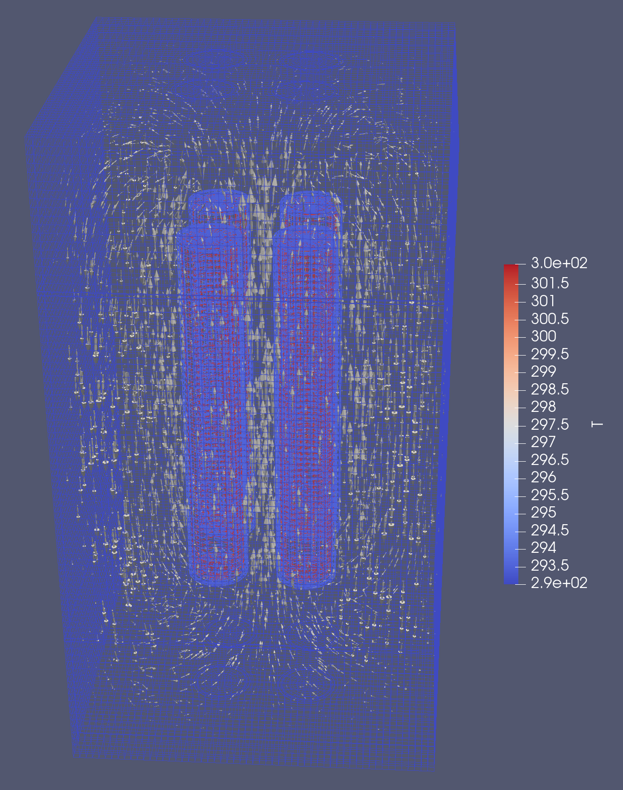
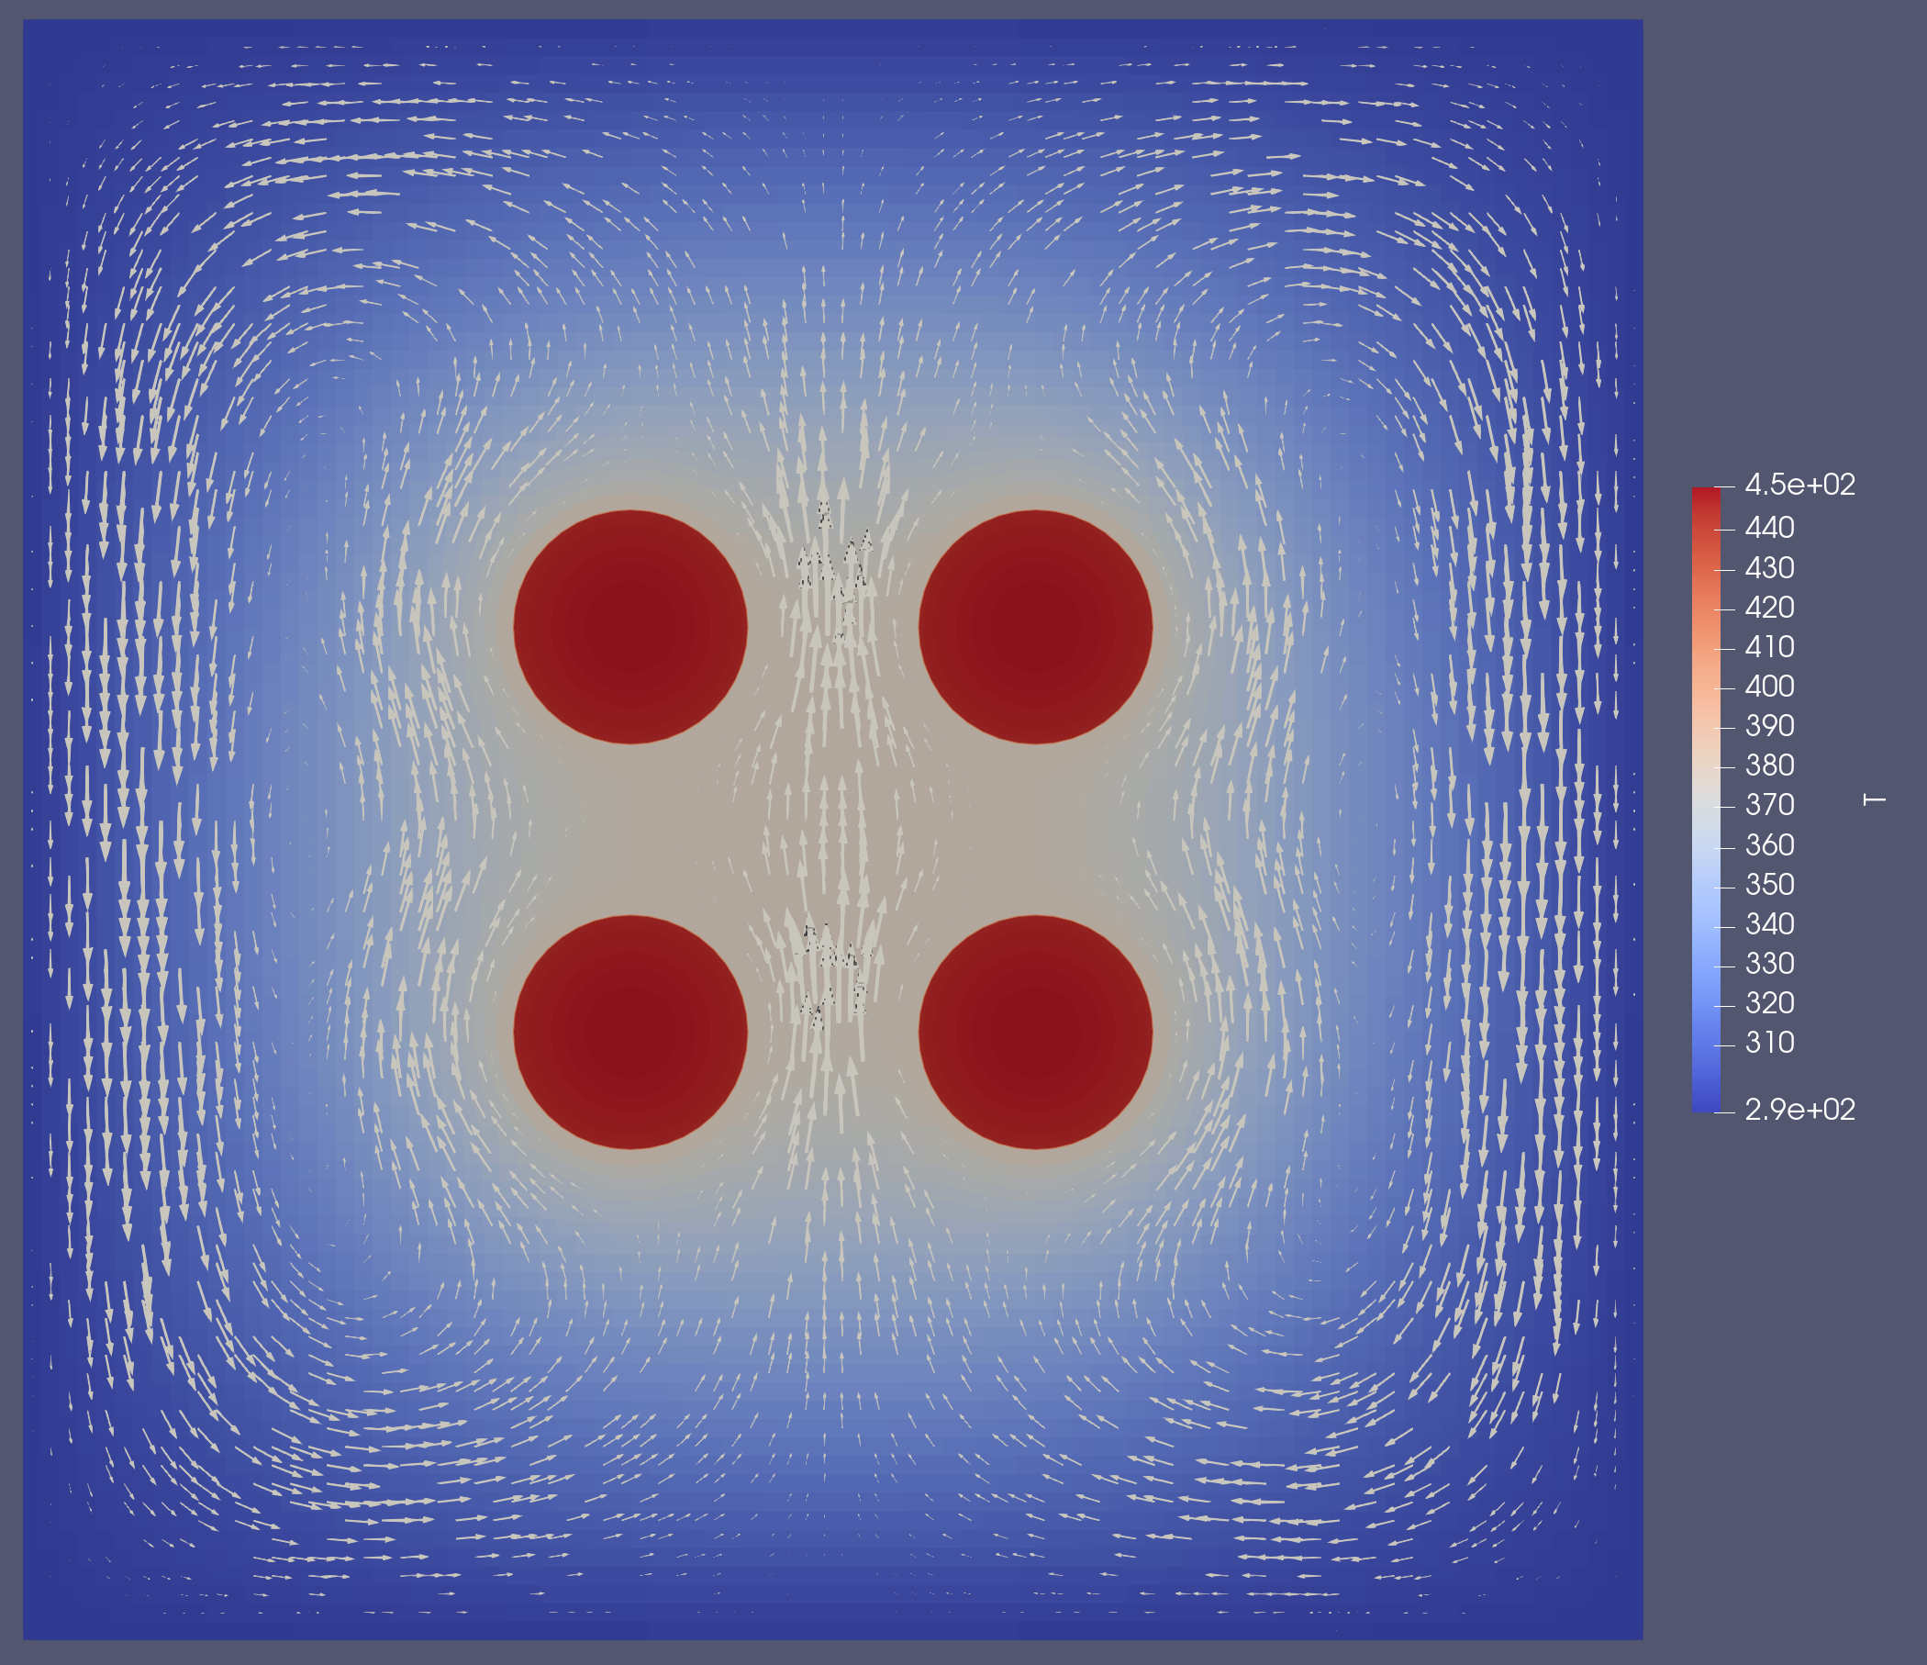
Modeling & Simulation Tools for Cask Simulation
MOOSE:
Navier-Stokes module
Natural convection loop
Multiapp system
TRISO fuel
Convection loop around spent fuel rods (3D)
Convection loop around spent fuel rods (2D)

Slide 3
Applicability to Spent Pebble Bed Fuel Storage
Source term obtained from gPBR depletion model
DOE standard canister chosen for storage
2D axisymmetric porous flow cask simulation using 2,000 randomly placed pebbles as source terms

Slide 4
In-Progress
Learn BISON models for pebbles for embedding multiscale fuel models
Learn OpenMC for XS generation
Generate detailed cask source term

